Slide 1
Strategic Framework for Portuguese School Libraries:
2014-20
Elsa Conde
Ministry of Education and Science
School Libraries Network Agency
Portugal
International Association of School Librarianship Conference
Moscow 2014

Slide 2
School Libraries Network Program: 1996-2014
2 423 school libraries
(all schools have a library or benefit from a library service)
1 000 000 students with library in their school
45.000.000,00 € invested
more than 700 networked information systems and online catalogues
more than 30 different types of applications, projects and partnerships
1 362 teacher-librarians

Slide 3
Europe 2020

Slide 4
Strategic Framework for Portuguese School Libraries: 2014-2020

Slide 5
Learn with the School Library

Slide 6
School Library Evaluation Model

Slide 7
1. Places for knowledge and innovation, able to incorporate new pedagogical practices
Provision of educational contents and computer applications to support research, communication and students schoolwork
Training of human resources in areas related to the curriculum and the information, media and digital literacy
Follow-up of the implementation of the benchmark Learn with the School Library
Escola Virtual

Slide 8
2. Spaces for social integration, essential to combating exclusion and school drop-out
Adaptation of the work of libraries and expand their capacity to respond to new types of audiences and needs
Framing school libraries in the global policies and strategies for combating failure, exclusion and students’ drop-out
Strengthening the social, cultural and educational value of libraries in schools and communities, through initiatives and projects of social intervention
Voluntariado de Leitura

Slide 9
3. Places of training and development of reading competence, condition of all knowledge
Production of materials and instruments to support the work of the libraries in the areas of learning to read and of readers training
Enhanced support for projects and contests geared towards the development of reading skills
Participation in initiatives to stimulate the relationship between reading skills and other domains of knowledge - Science, Literature, Art, ...
Newton gostava de ler

Slide 10
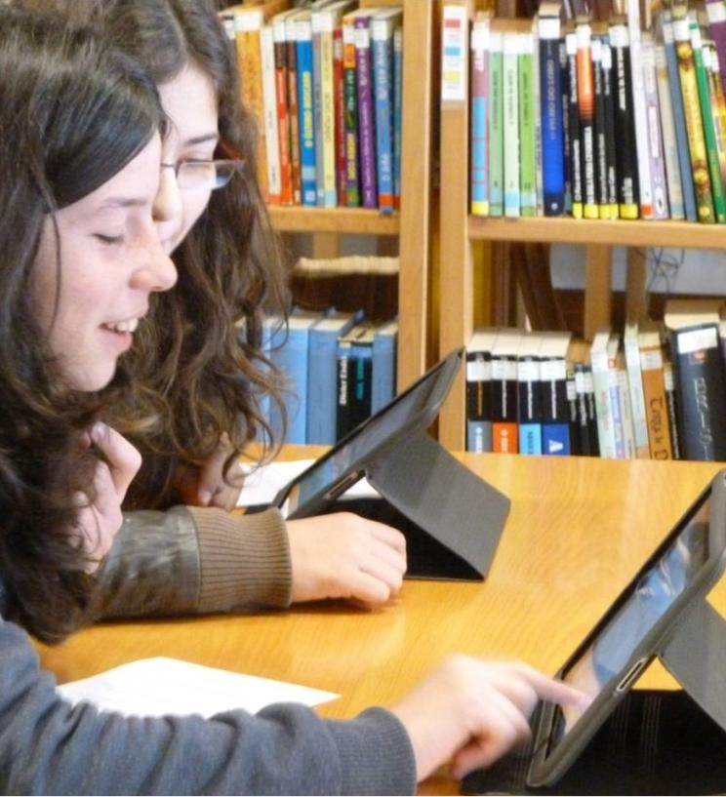
4. Spaces diffusers of the pleasure of reading, essential to the construction of reading habits
Promotion of updated information resources, by encouraging the introduction of new lending forms and reading devices
Partnership with promoters of autonomous reading programs and recreational, in particular the National Plan for Reading
Participation in research studies on new ways to read
EB Galopim de Carvalho

Slide 11
5. Teaching areas, essential to the training for the digital, media and information literacy
Follow-up of the implementation of the benchmark Learn with the School Library
Articulation with other services of the Ministry of Education and Science, with the purpose of integrating the library into the curriculum and into programs or activities associated with the development of different skills
Partnerships with universities and other organizations for the production of contents, training and studies
7 dias, 7 dicas com os media

Slide 12
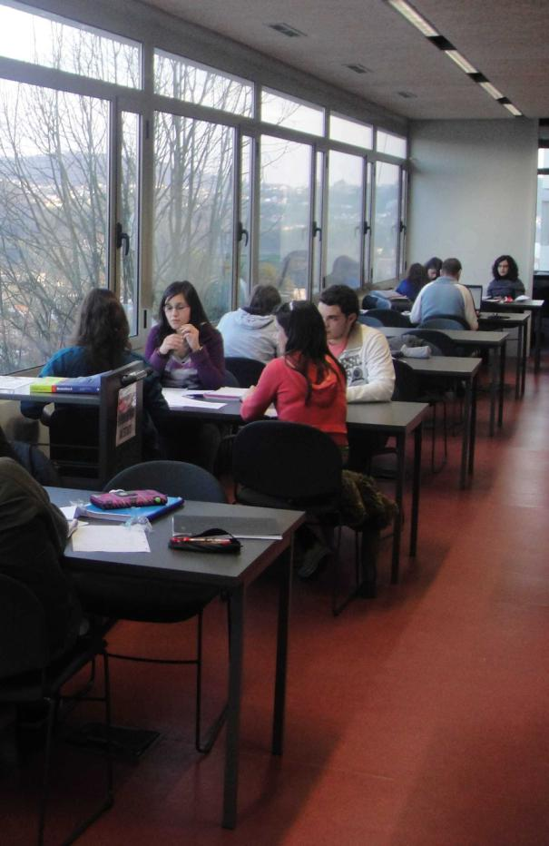
6. Centres of pedagogical support, crucial for the fulfilment of goals of school education
Adequacy of policies, guidelines and management of libraries to changes in school and in the education system
Coordination with other services of the Ministry of Education and Science, to include the school library and its goals in the general educational measures
Promotion of an institutional dialogue with the schools management bodies, to improve their educational service
ES Penafiel

Slide 13
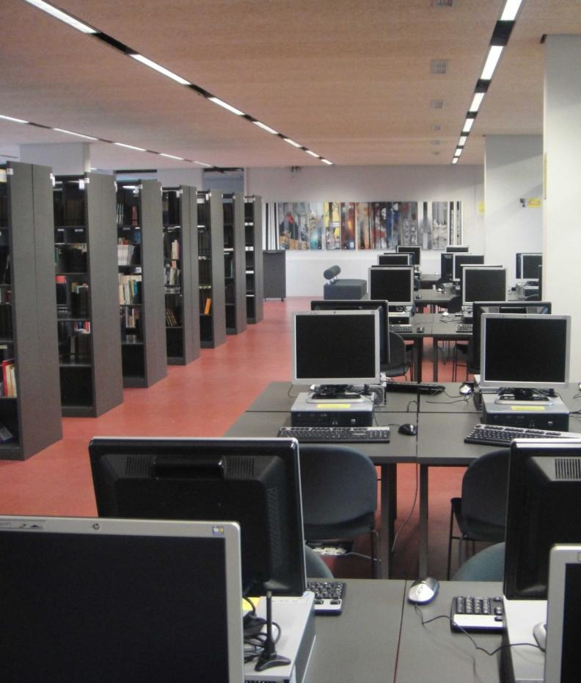
7. Flexible environments adapted to technological change and to user needs
Revision of the technical guidelines and conditions for the installation and equipping of school libraries
Conversion of the physical space of the libraries and upgrade of equipment and software
Contacts with institutions and companies providing furniture, equipment, software and other specific goods
ES Penafiel

Slide 14
8. Structures led by skilled teacher-librarians, able to respond to functional and pedagogical requirements of the school
Ensuring institutional procedures which ensure the affectation of qualified professionals to school libraries
Further training of teaching and non-teaching staff, partnering with Training Centres Associations of Schools, Universities and other training providers
Definition of human resources management policies to ensure the smooth operation of the libraries

Slide 15
9. Information services with digital contents and technological resources able to respond to social changes
Incorporation of results of studies and recent practices, to pursue the cooperative management of the collections, the acquisition of documents in digital formats and the implementation of electronic loans
Promote interlibrary partnerships and pursuing the creation policy of digital libraries and collective catalogues
Revision of the guidelines of the SLNP on the management of the collection
Promethean

Slide 16
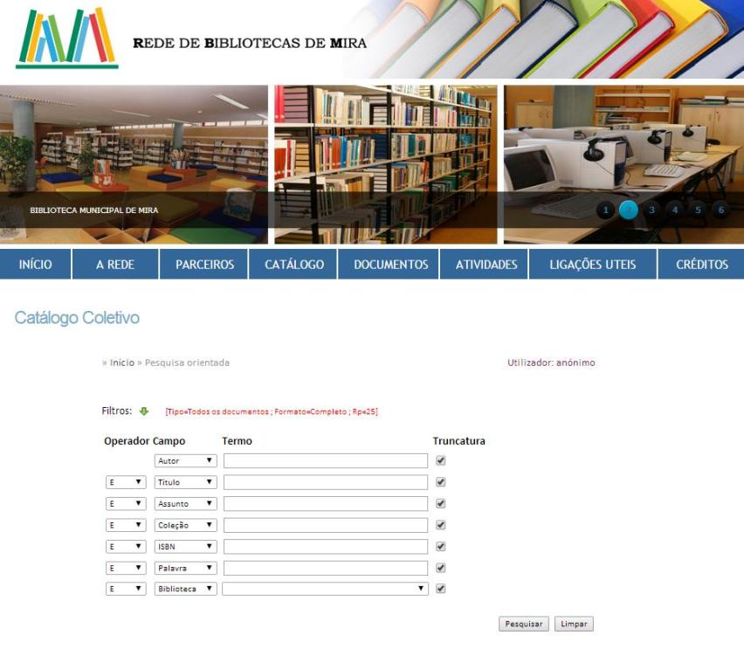
10. Dynamic and sustained networks with consistent practices, embedded in the community
Development and consolidation of local networks – collective catalogues, portals, cooperation projects, training, ...
Increase and diversification of partnerships with communities, involving families and other interlocutors
Provision of platforms and information systems that facilitate the creation of networks and systems of cooperation at the local level

Slide 17
11. Cooperation systems with the society, sharing resources and knowledge
Consolidation of partnerships, projects and cooperation agreements established with different entities
Creation of new partnerships at national and international level
Elaboration of studies and evaluation reports on results of projects developed

Slide 18
12. Inclusive organizations, guaranteeing equal access to services and information resources
Support for updating and continued diversification of information resources, in order to accompany the variety of interests and needs of different audiences
Creation of physical and technical conditions to make libraries able to provide differentiated answers to students with special educational needs or other specific needs
Strengthening of partnerships and projects promoting equal access to information and social inclusion

Slide 19
13. Management units oriented for quality and excellence
Dissemination of good practices and results of the libraries
Carrying out studies showing the impact of libraries
Support for the improvement and development plans of the libraries, particularly those which present major difficulties

Slide 21
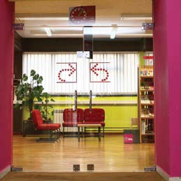
THANK YOU!
elsa.conde@mail-rbe.org

