Slide 1
BOOKMARKS PROJECT-2016

Slide 2
INTERNATIONAL PROJECT OF SCHOOL LIBRARIANS AND FOREIGN LANGUAGE TEACHERS
AIM :
to make students aware of importance of a school library as a place where students are prepared for life and the process of lifelong learning, as well as the information and cultural centre of school;
promoting multicultural diversity;
developing art and literal creativity in students

Slide 3
Ways of implementation:
students in groups and individually make bookmarks for their colleagues abroad on given subject throughout October in workshops organized in the school library,
they make bookmarks about their school, town and country which we sent to our colleagues abroad;
they plan an exhibition with their English teacher and the librarian in which they exhibit information about the partner-school and their work

Slide 4
Project coordinators:
Main project coordinator is Ms. Breege O'Brian from IASL (Northern Ireland)

Coordinator of Bookmarks project in our school is Melisanda Masnica, a school librarian

Collaborator in the Project is Vanesa Ficko Berić, an English teacher and her 7A class and members of Book’s Friend Club

Slide 5
Timeline of activities:
September:application, selection and agreement of school libraries all over the world about their involvement in the project and their collaboration through the main coordinator Breege O'Brian from IASL.
September-October:
1 Planning and making of bookmarkers ( Croatian ethno motives, in a shape of a tie and Croatia, Licitar hearts,
2 Work on a Powerpoint presentation and written presentation about our country, town and school with th accent on our subject :
3 Tradition and customs of our county; writing a letter to our colleagues abroad in English; making of flyers about the school in English
4 Making a video about our project( teachers Miroslav Matić, Ivica Lalić and Domagoj Pešut)

Slide 6
Timeline of activities:
24th October: to mark International Day of School Libraries we exchange bookmarks with Shenton College, Perth, Australia; sending of conclusion report on carried out activities in the project with photographs and a video to the main coordinator
Connection with our partner-school via Skype and talking to them after bookmars exchange
December: presentation of the project on a parental meeting
February:Presentation of the project in our Teacher’s meeting

Slide 7
ŠKOLA PARTNER: PARTNER-SCHOOL:SHENTON COLLEGE
Shenton College is a co-educational public secondary school located in Shenton Park, a suburb of Perth, Western Australia
Shenton College was established in January 2001 through the amalgamation of Swanbourne and Hollywood Senior High Schools at a cost of $23.5 million.
23 students aged 12-13
Their librarian Brenda Clover

Slide 8
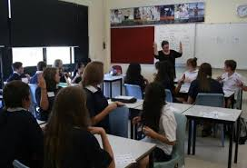
Shenton College - photos

Slide 9
First workshop in our library
Thursday, 6th October 2016
Librarian Melisanda Masnica, 7.a students and English teacher Vanesa Ficko Berić
BOOKMARKS PROJECT – general information
To inform the students and the teacher about project aims and a way of carrying out the project,
869 schools from all over the world appied for this project
Duration time– October 2016- the month of School Libraries
Partner-school( we are 460 – our partner 697) - , SHENTON COLLEGE 227 STUBBS TERRACE– SHENTON PARK WA 6008, AUSTRALIA, (Western Australia, Perth)
Contact: BRENDA CLOVER, e-mail: bclover@shenton.wa.edu.au
43 students aged 9-13
How to present our school, town, county and Croatia?
Write a letter (e- mail) in which we are going to present ourselves to our Australian partners
Three groups of students:
1 Present your class and school (in English)
2 Present out town and county
3 Present Croatia: sights, history, tourism…
Students’ texts form in a letter(V.Ficko Berić)
Photograph of us
Writing e- mail with the photo of us
Announcing creative workshops for next week – making of bookmarkers for exchange with our partner-school
Techniques: crayons, felt-pen, colored pencils,collage

Slide 10
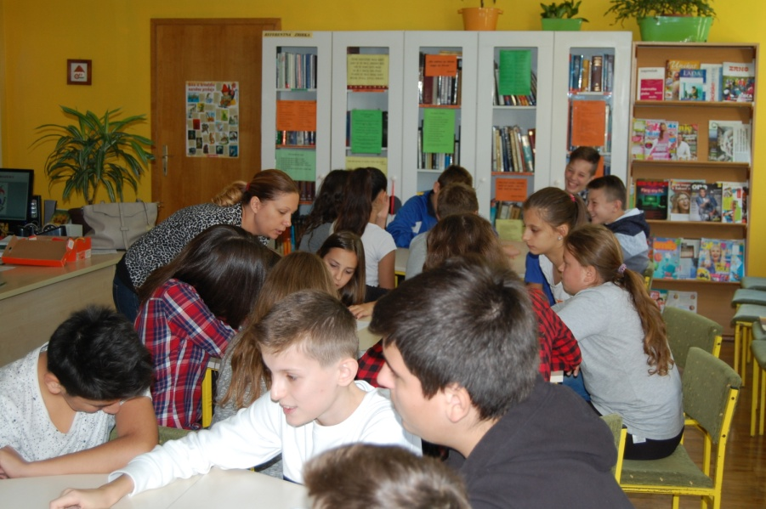
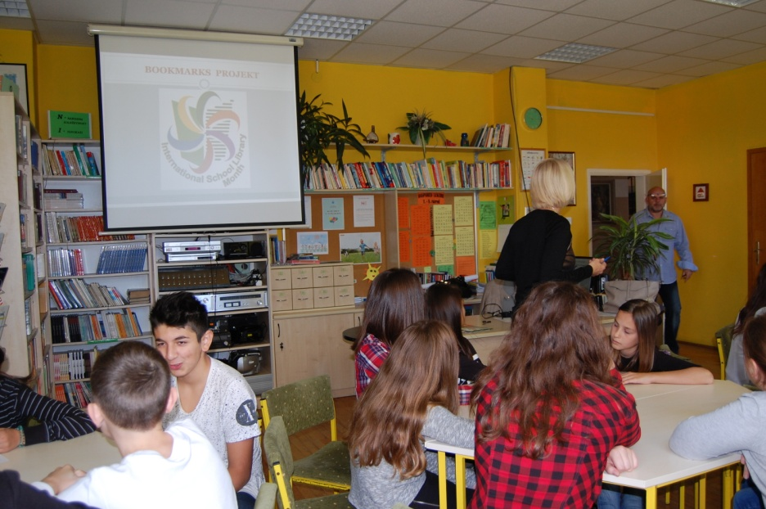
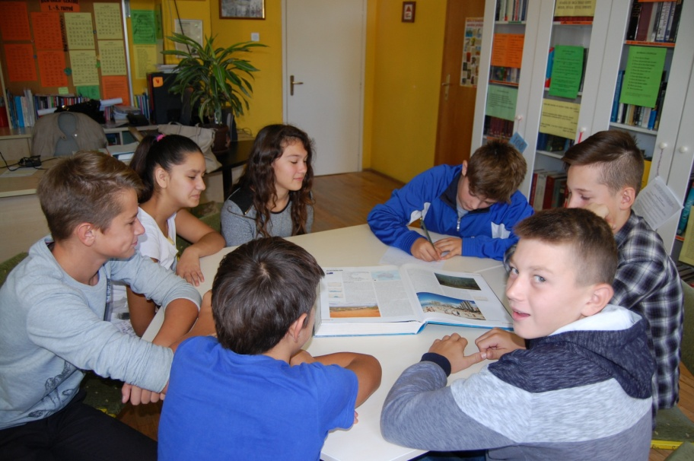
First workshop- photos

Slide 11
Our students’ letter:
Hello from Novska!
We go to the 7th grade and we are mostly thirteen-year-olds. We go to Novska's Elementary school. Our school is the biggest school in our county and we have the highest number of students, as well. Our school is also the only elementary school in our town.All children 7-15 go to our school and this year we have 825 students.
Novska is a small town with a beautiful park in its centre, a nearby lake and oak forests all around it.
Novska is in a part of Croatia called West Slavonia, in Sisak-Moslavina county. Our county is best-known for our Nature reserve “Lonjsko polje“. There is a famous European stork village called Čigoč (Chigoch) in “Lonjsko polje“ .
The biggest Croatian river flows through our county and it is called the Sava.
Croatia is a country at the crossroads of Central Europe, Southeast Europe, and the Mediterranean.
We are members of the EU since 2013. Our capital city is Zagreb.
There are a lot of beautiful sights in our country, many of them are protected by UNESCO. We also have a lot of national parks and nature reserves, one of the most famous are The Plitvice Lakes.
Dubrovnik with its Walls, Split with Diokletian palace, Pula with Amphitheatre and our gorgeous Adriatic coast with around thousand islands are just some of the reasons why Croatia is special.
We will show to you some of our symbols on our bookmarks.
Best regards!
Your friends from Croatia, Novska!

Slide 12
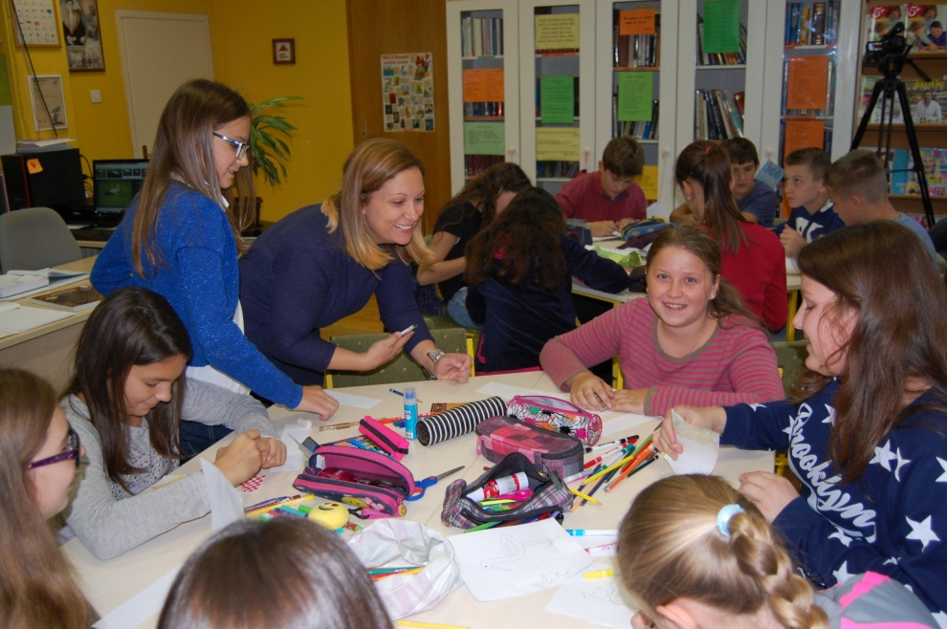
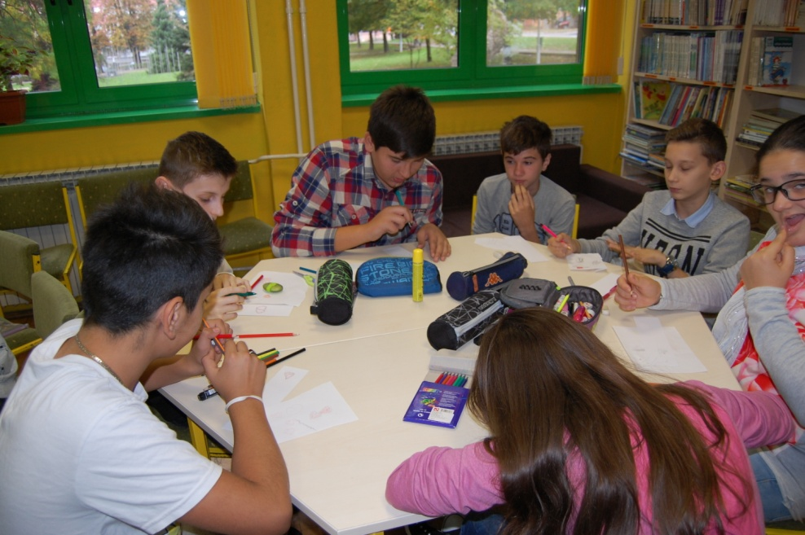
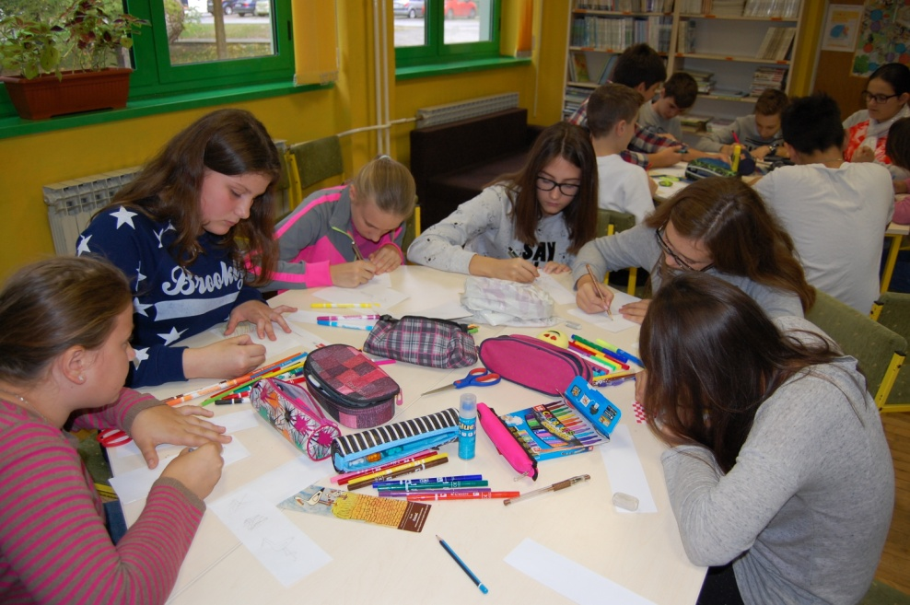
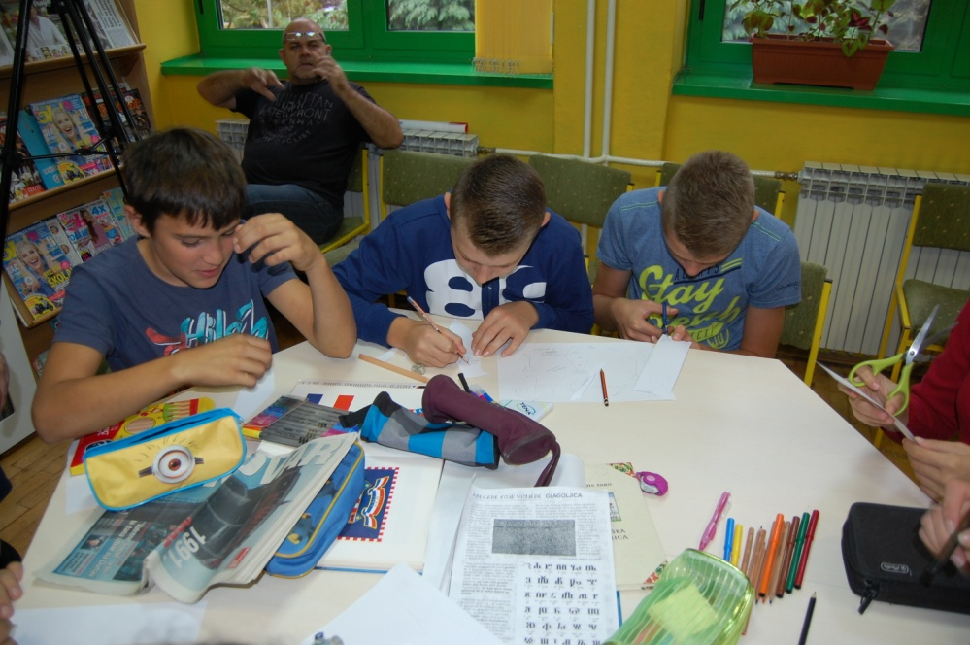
Second workshop- (making of bookmarkers)

Slide 13
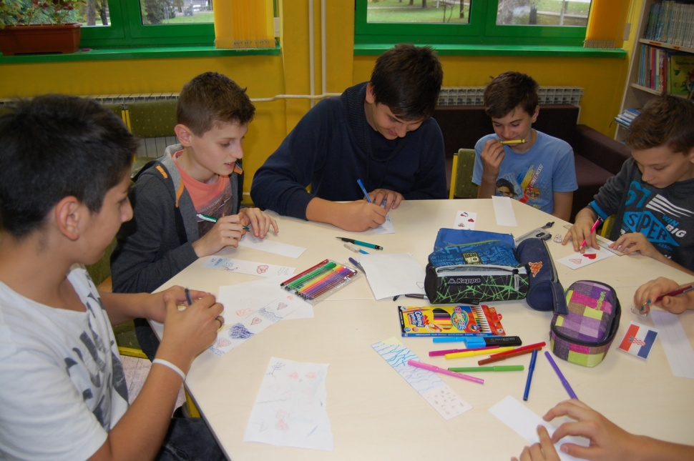
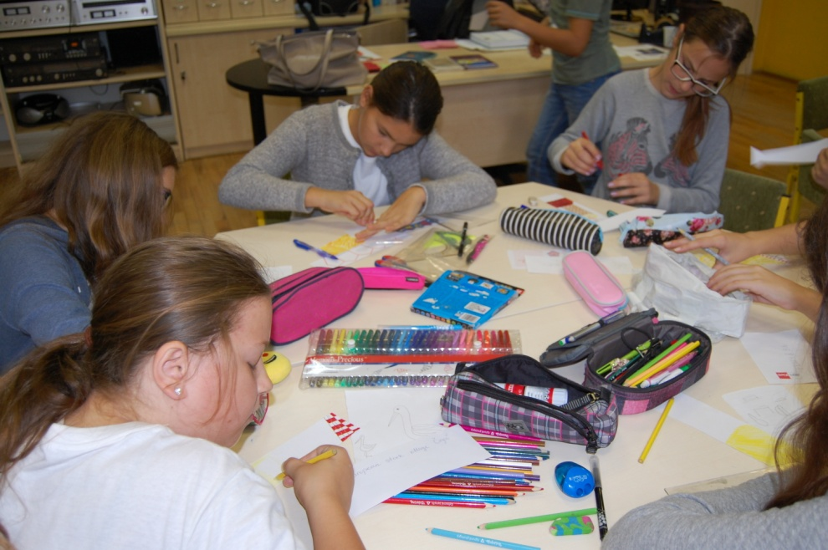
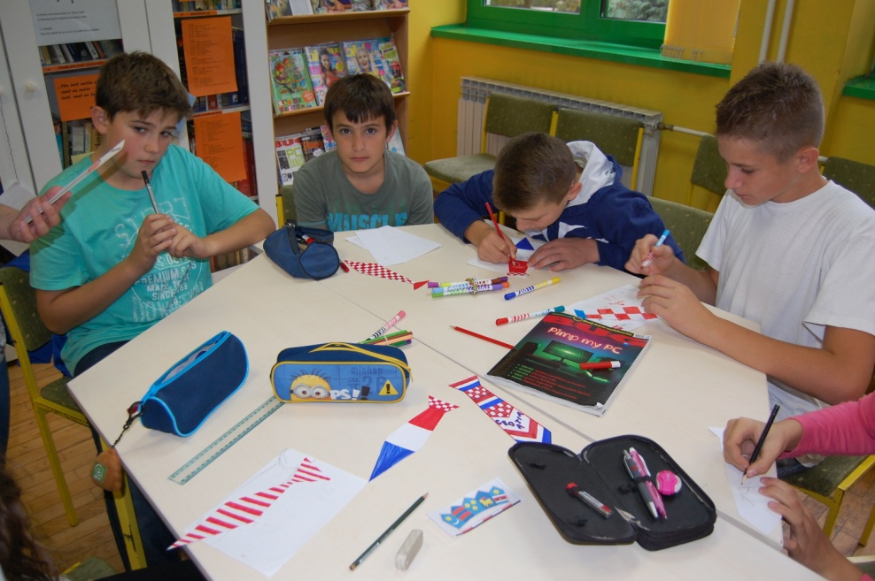
Third workshop (making of bookmarkers)

Slide 14
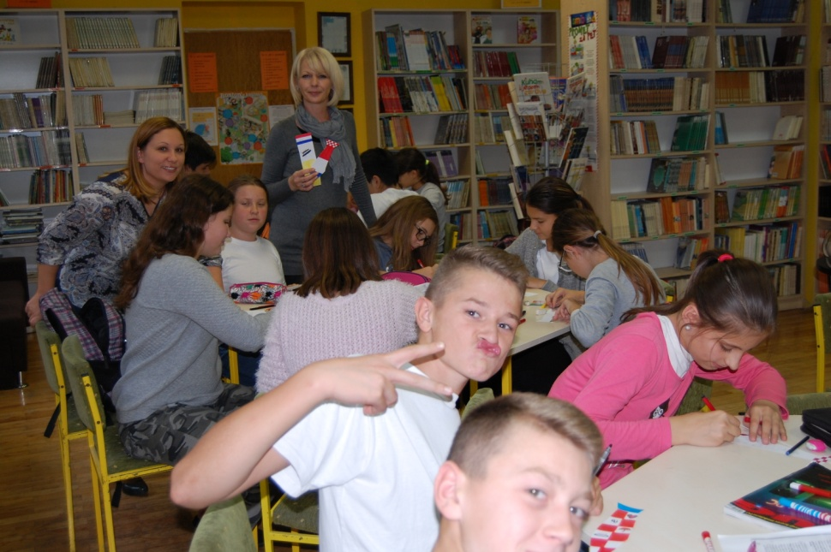
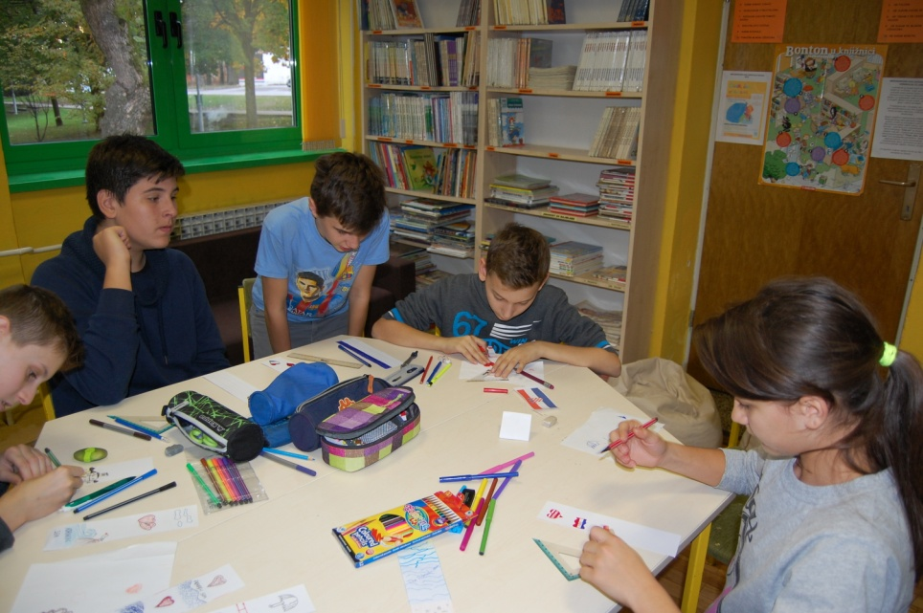
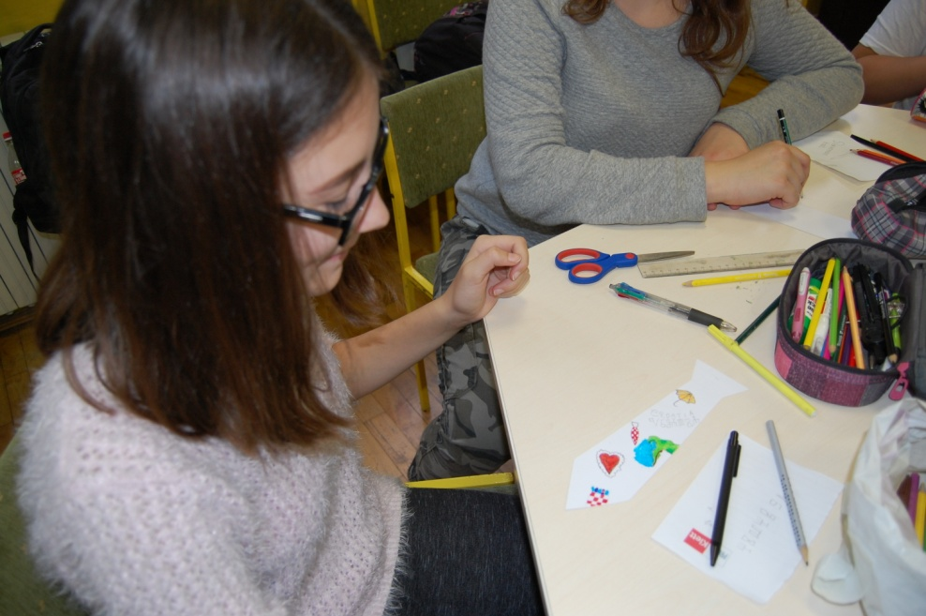
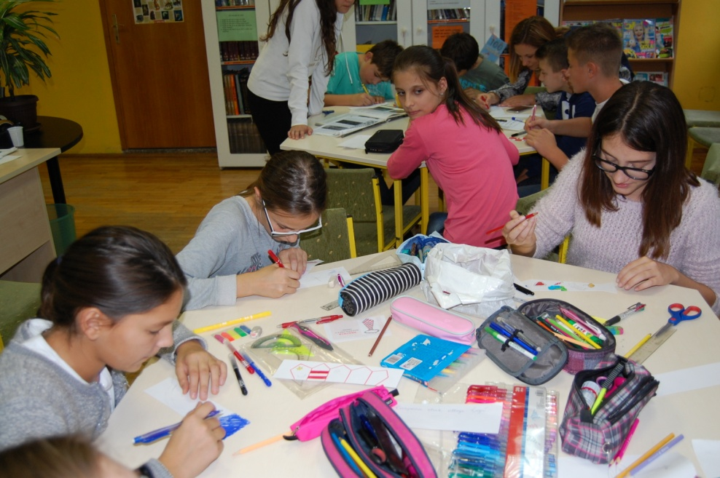
Fourth workshop - Making of a video clip

Slide 15
E-mail from Australia
From: Brenda Clover <bclover@shenton.wa.edu.au> Date: 2016-10-24 6:06 GMT+02:00 Subject: ISLM - Bookmark Exchange Project 2016 To: "rosa67.lind@gmail.com" <rosa67.lind@gmail.com>
Hello Melisanda Masnica
We are a metropolitan high school on the west coast of Australia (in Western Australia).
The students participating in the Bookmark Exchange are 12-13 years old and are very excited to
be swapping bookmarks with your students.
This is our first year taking part in this project.
Our School Website: http://www.shenton.wa.edu.au/
I look forward to hearing from you.
Thanks, Brenda
Brenda Clover Teacher Librarian
Shenton College
227 Stubbs Terrace
Shenton Park WA 6008
Phone: 9488 2100
www.shenton.wa.edu.au
Phone: 9488 2100
www.shenton.wa.edu.au

Slide 16
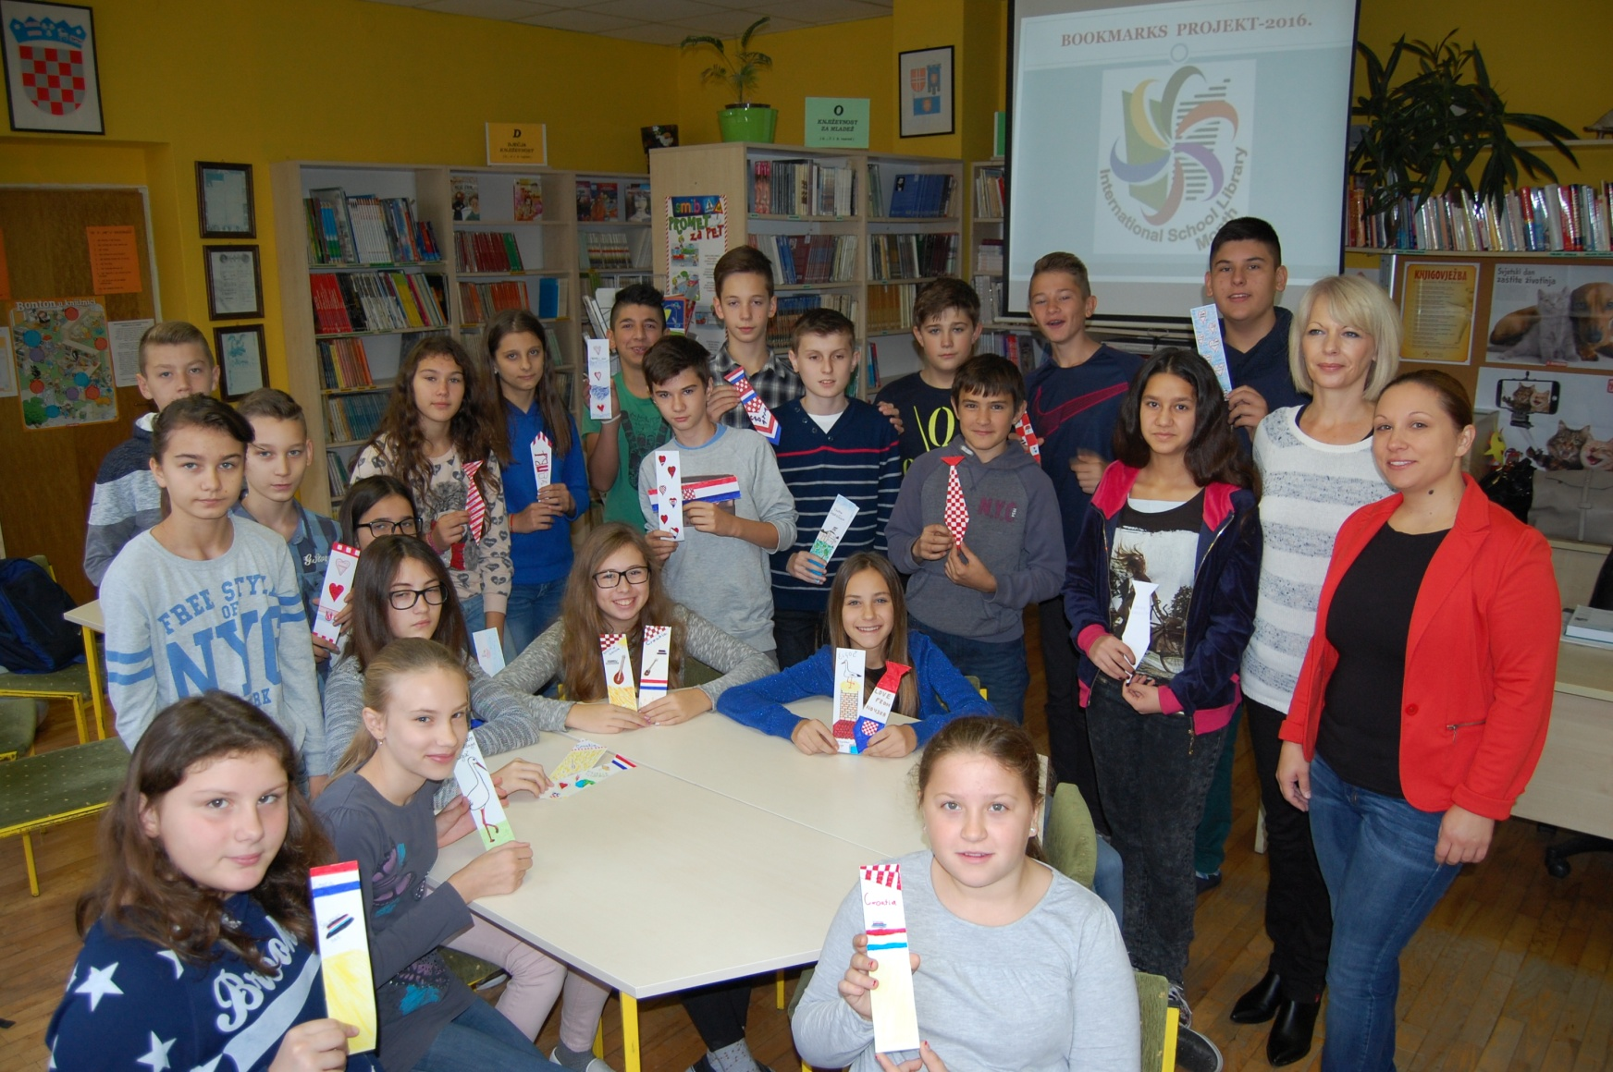
All bookmarker are completed

Slide 17
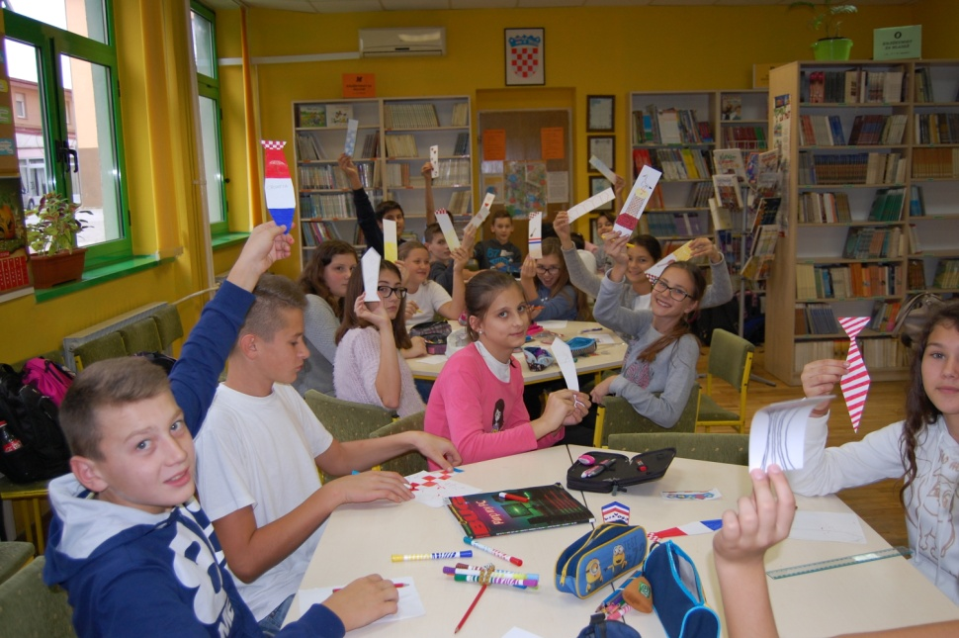
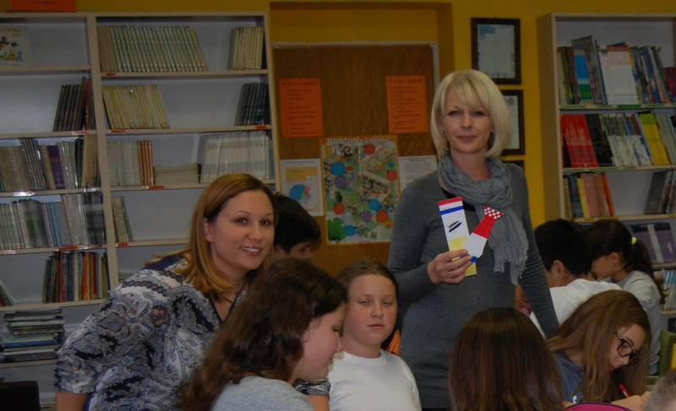
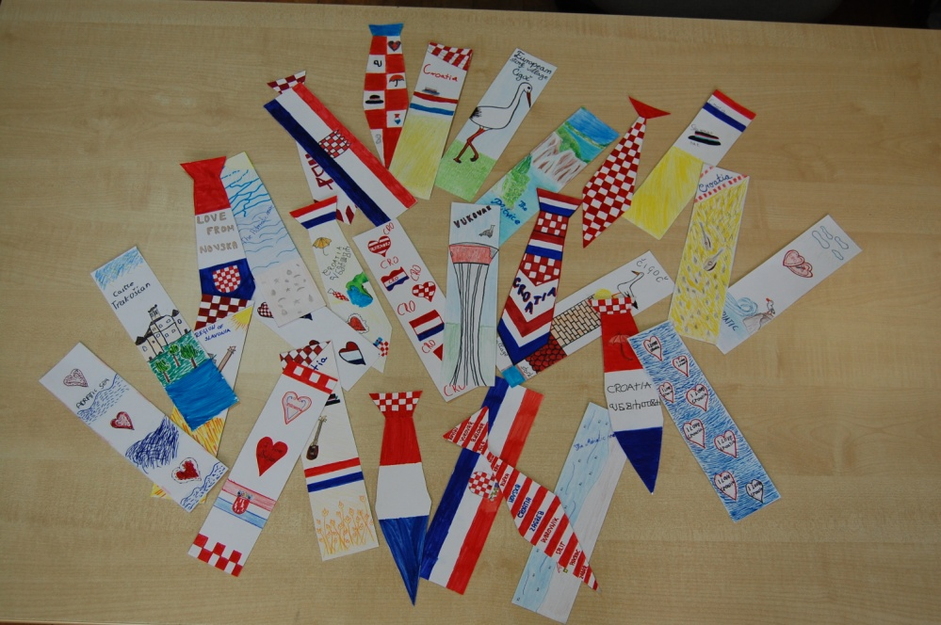
More photos

Slide 18
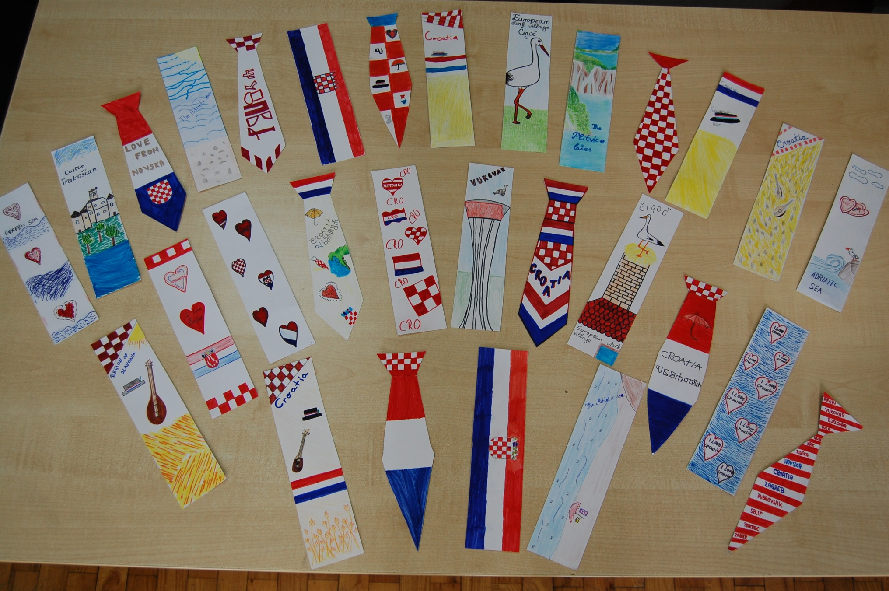

Slide 19
We send to Australia ours bookmarkers

Slide 20
The presentation of the report prepared
coordinator of Bookmarks project in our school :
Melisanda Masnica, librarian at the Elementary school Novska, Croatia
Translation of the report into English: Vanesa Ficko Beric, teacher of English
in Elementary school Novska, Croatia

